Slide 1
Password generator
My Hong T nguyen
IS 3202
11/30/2022
https://github.com/ksu-is/Create-the-password-

Slide 2


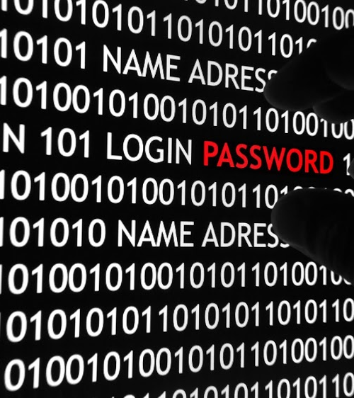
Reason why Password lost
Using personal information
Using day of birth
Using same password for every accounts
Using short password

Slide 3
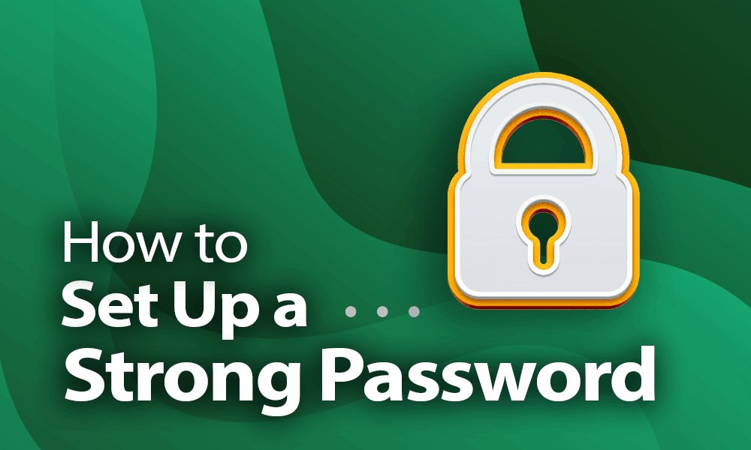

Slide 4
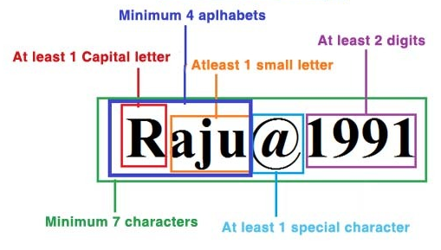
RULE
The strong password should be more than 7 character but not limited; includes upper/lower letters, number, and special characters.

Slide 5
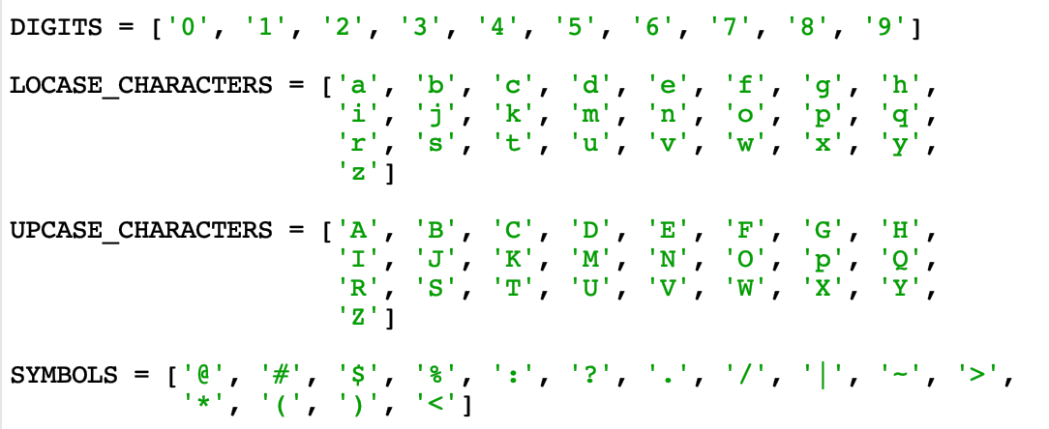
Notes:
I GONNA CREATE FOLDER; DIGITS FOR NUMBER, LOCASE AND UPCASE FOR LETTER, ALSO SYMBOLS FOR SPECIAL CHARACTORS.

Slide 6
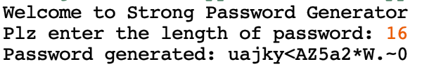
Length
We can set the length for password, with random order.

Slide 7


